Slide 1
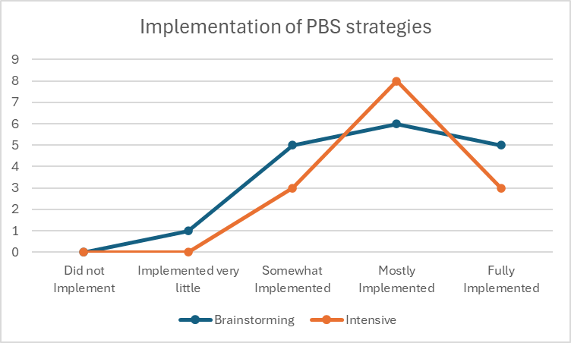
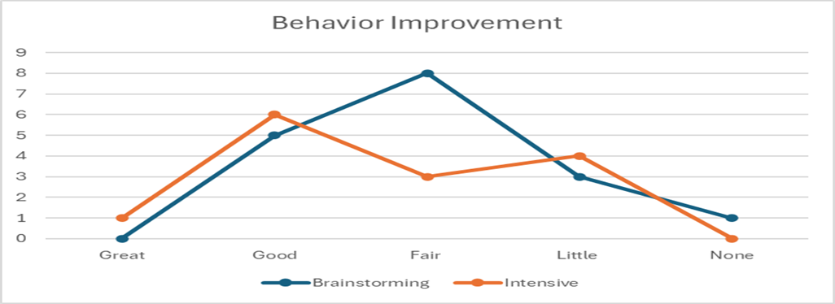
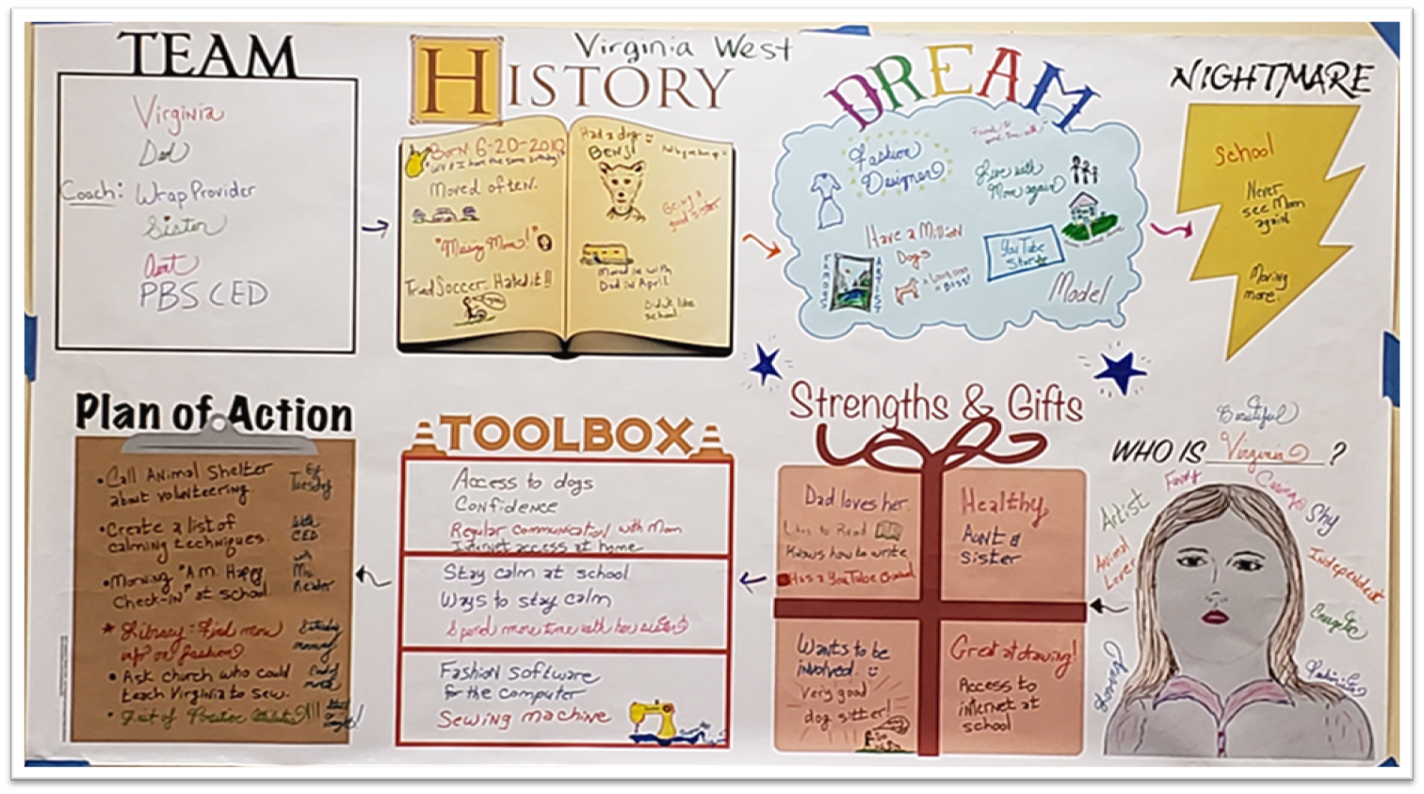
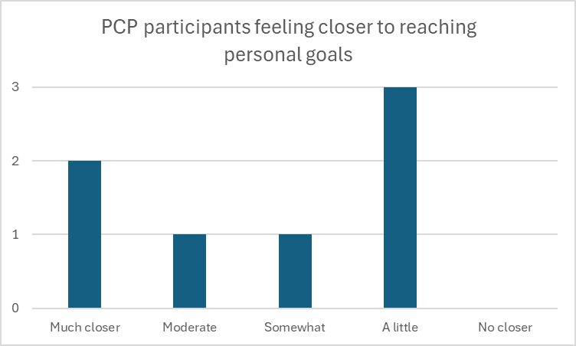

Positive Behavior Support effectiveness and outcomes in WV
Positive Behavior Support effectiveness and outcomes in West Virginia
Anastasia Riley, MBA CBIS, Nicholas Larson, MA; Jacqueline Loud, BS; Heather Merritt, MS; Teresa Bhaile, MAT; Ashley Benson, MS; Sandra Corbett, MSW, LICSW; Cassandra Bent, BA; Celia Shi Ph.D; Lauren Swager, MD.
West Virginia University, Center for Excellence in Disabilities, Morgantown, WV
Background
Pre and Post Risk of Out-of-Home Placement and Caregiver Confidence
Implementation after Brainstorming versus Intensive PBS services
Positive Behavior Support (PBS) examines the physical, social, educational, biomedical and logistical supports needed to achieve basic lifestyle goals while reducing problem behaviors and emphasizing a commitment to helping individuals achieve a quality of life that is defined by their personal choices. ¹
The Substance Abuse and Mental Health Services Administration (SAMHSA)’s Eight Dimensions of Wellness gives an empirical model to assess wellness. ²
The WV Positive Behavior Support Program utilizes the SAMHSA model as a baseline and post-service quality measure to target quality of life interventions. The PBS plans focus on teaching and reinforcing functionally equivalent replacement behaviors as well as addressing each quality-of-life dimension.
Risk of out of home placement decreased on average following all three behavioral services. The greatest reduction in out of home risk was reported following the Intensive service delivery. Intensive Service recipients also had the highest baseline levels of risk and lower caregiver preparedness in contrast the Brainstorming recipients. Caregiver preparedness was not measured post services for the PCP recipients.
Caregivers were taught to implement the behavioral strategies within the Positive Behavior Support Plan. Survey results indicate caregivers did implement to varying degrees.
Objective
Examine the changes in risk of out of home placement, perceived behavioral improvement and caregiver confidence following PBS services, to help increase overall quality of life.
*
*
Methods
Risk of out of home placement
0 = No risk
5 = Moderate Risk
10= Intense Risk
Caregiver Preparedness
0 = Extremely Confident
5 = Moderate amount of confidence
10 = Extremely worried and unprepared
Behavioral Improvement Post-PBS Services
Three services were delivered to West Virginians on a volunteer basis:
  Brainstorming: 1-hour telehealth session to discuss specific ways to implement PBS strategies.
  Person-centered planning: A fun way to create an action plan to increase quality of life.
  PBS intensive services – An individual Functional Behavior Assessment (FBA) and Trauma-Informed Positive Behavior Support Plan conducted for up to 6 months.
A RedCap form provided baseline data on the risk of out-of-home placement, caregiver preparedness, quality of life measure, demographics and behavioral descriptors.
Participants that were not deemed eligible for intensive services still received brainstorming and/or person-centered planning services, ensuring all who sought support received some level of PBS assistance.
Participants were provided a Qualtrics satisfaction survey two weeks post service discharge to reassess risk and quality of life based on the eight dimensions of wellness.
Data from 17 brainstorming surveys and 14 intensive services surveys showed 96.7% of the 31 participants reported a behavioral improvement two weeks post-PBS services.
Person-Centered Planning
  Person-centered planning services can involve Making Action Plans (MAPs) or Planning Alternative Tomorrows with Hope (PATHs) facilitation.³ The WV PBS Program hosts trainings to teach providers how to facilitate MAPs and PATHs. The image below in an example of a MAP.
Conclusion
Findings/Results
Positive Behavior Support services are useful at making behavioral improvements in general across all domains of life in West Virginia.
The reduction in risk of out of home placement will hopefully keep more WV youth with their families and in their communities, lessening institutional costs and burden in addition to keeping families connected and thriving.
Further examination of the eight dimensions of wellness data will be explored for the participants who received intensive services.
163 participants were provided services in FY24 for a total number of 4,389 clinical interactions.
119 total satisfaction surveys were completed indicating an overall 97% satisfaction rate in clinical services. Of those surveys:
  17 Brainstorming surveys indicated 100% satisfaction
  7 Person-centered planning surveys indicated 100% satisfaction
  14 Intensive services surveys indicated 100% satisfaction
  81 general satisfaction survey cards indicated 95% satisfaction
The data described within this poster highlights the three individual services regarding client specific ratings of outcome variables as well as satisfaction. Scores were based on a match of specific individual data pre and post services to ensure validity.
All three services showed an overall reduction in risk of out-of-home placement from an overall average score of 5.43 to 2.91 post-WV PBS service delivery.
100% of the 7 total person-centered planning survey responses reported “yes” to the question “do you feel more empowered because of person-centered planning?”
**
References
²Das, Dipanjana, "Empirical Investigation of SAMHSA’s (Substance Abuse and Mental Health Services Administration) Model of Wellness" (2015). CUNY Academic Works.
https://academicworks.cuny.edu/cc_etds_theses/536
¹Dunlap, G., Sailor, W., Horner, R.H., Sugai, G. (2009). Overview and History of Positive Behavior Support. In: Sailor, W., Dunlap, G., Sugai, G., Horner, R. (eds) Handbook of Positive Behavior Support. Issues in Clinical Child Psychology. Springer, Boston, MA. https://doi.org/10.1007/978-0-387-09632-2_1
³Jack Pearpoint & Lynda Kahn, Co-Directors, Inclusion Press. Person Centered Planning: PATH,MAPS and Circles of Support. https://inclusion.com/path-maps-and-person-centered-planning/
This poster is a product of the findings of the WV Positive Behavior Support Program at the WVU Center for Excellence in Disabilities which is funded by the WV Dept of Human Services Bureau for Behavioral Health.
Pending WVU IRB Protocol # 2410047005

